Slide 1

Real-Time Object Detection with SSD and MobileNetV3
This presentation explores a high-speed, accurate object detection system leveraging the SSD (Single Shot Multibox Detector) architecture combined with the lightweight MobileNetV3 backbone. Trained on the extensive COCO dataset, this system excels at detecting and localizing multiple objects in real time. Its balance of speed and precision makes it ideal for various applications ranging from mobile vision to surveillance, bringing cutting-edge AI capabilities to resource-limited devices.
M.Sritej - E22CSEU0354
Akash Varma - E22CSEU0333
Teja Kiran – E22CSEU0345

Slide 2
Introduction to Object Detection
What is Object Detection?
Methods and Applications
Object detection involves identifying and localizing objects within an image or video, combining classification and bounding box estimation. It goes beyond simple recognition, providing precise locations of multiple objects.
Traditional methods relied on handcrafted features and classifiers, but modern systems use deep learning for superior accuracy. Applications include autonomous driving, where timely detection is critical, surveillance systems ensuring safety, and robotics guiding intelligent navigation.

Slide 3
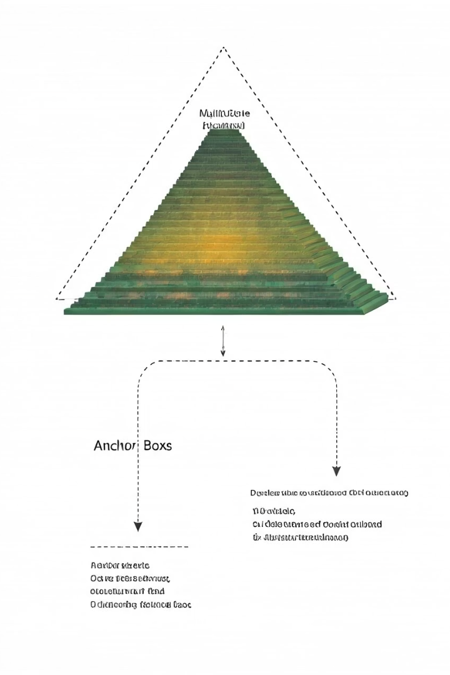
SSD Architecture: Single Shot Detection
One-Stage Detection
Multi-Scale Feature Maps
Processes image in a single pass, enabling faster detections compared to two-stage detectors.
Utilizes features at several resolutions to accurately detect objects of varying sizes within the image.
Anchor Boxes
Predefined boxes predict offsets and confidence scores to precisely localize objects across different shapes and locations.

Slide 4

MobileNetV3 Backbone for Efficient Inference
Lightweight Design
Depthwise Separable Convolutions
Optimized for mobile and embedded devices, balancing performance with computational constraints.
Reduces operations by splitting convolutions, enabling faster processing and lower energy usage.
Low Memory Footprint
Minimizes memory use while maintaining accuracy, ideal for real-time applications on mobile hardware.

Slide 5
Training on the COCO Dataset
Comprehensive Dataset
Data Augmentation
COCO contains 330,000 images with 1.5 million labeled objects spanning 91 categories, providing rich context for training robust models.
Techniques like flipping, scaling, and color adjustments improve model generalization and performance on unseen data.

Slide 6




System Implementation and Performance
Speed
Accuracy
Hardware Requirements
Operates at 30 frames per second, enabling smooth real-time detection even on resource-constrained devices.
Achieves a mean average precision (mAP) of 25, balancing precision with performance.
Requires minimal resources such as 4GB RAM and a mobile GPU, making it practical for widespread deployment.

Slide 7

Advantages and Limitations
Strengths
Weaknesses
Fast and efficient architecture suitable for mobile devices
Accuracy lower than heavier, multi-stage detection models
Good trade-off between speed and accuracy for real-world use cases
Performance can degrade in highly complex scenes
Future Directions
Research aims to enhance accuracy and further reduce computational demands with novel optimizations and model compression techniques.

Slide 8

Conclusion and Applications
Effective Real-Time Detection
SSD with MobileNetV3 provides a practical solution for real-time object detection with a balance of speed and accuracy.
Practical Applications
Enables mobile vision, augmented reality, smart surveillance, and robotics, especially where resources are limited but performance is crucial.
Future Opportunities
Ongoing development will push boundaries for deeper accuracy, adaptability, and broader deployment in diverse AI-driven domains.

